Slide 1

Sujith Quintelier – Member of Cloud of Expert (Azure)
Azure Overview
Notes:
Welcome
Introduction
CoE
Start from existing App

Slide 2
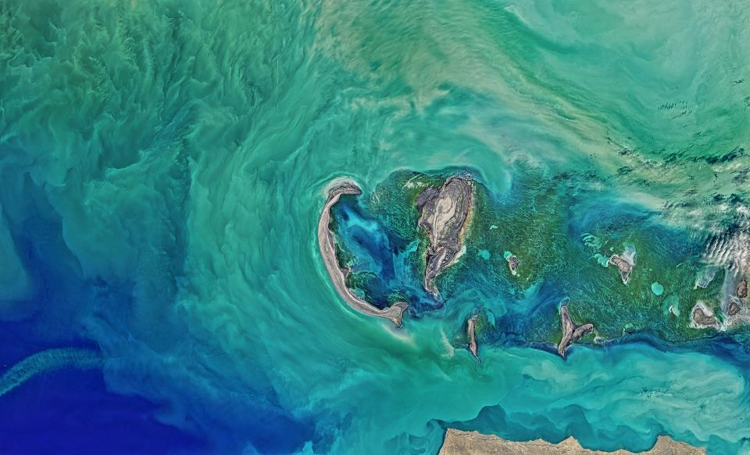
Next
VSTS
Notes:
From WorkItem To Deployment

Slide 3






01
VSTS
Planning
Git
CI/CD
VSTS
Notes:
TFS
Git
Github
Bitbucket
Jenkins

Slide 4
Next
Hosting

Slide 5



02
HOSTING
App Services
Web
Function
Logic
Notes:
Web Apps
Function Apps
Logic Apps

Slide 6

02
HOSTING
Virtual Machines
VM
Notes:
VM

Slide 7


02
HOSTING
Containers
ACI
ACR
Web
Notes:
Container Instances
Container Registry
Web For Linux/Windows Containers

Slide 8




02
HOSTING
Micro Services
Service Fabric
ACS
AKS
Service Fabric Mesh
Notes:
Service Fabric/Mesh
Container Service (CD/OS, Swarm, Kubernetes)
Kubernetes Service

Slide 9
Next
Data

Slide 10




03
DATA
Storage
Blob
File
Table
Disk

Slide 11






02
DATA
Database
SQL
Elastic
Pool
Data Warehouse
SQL
Stretch
Redis
Cache
Cosmos
DB
Notes:
SQL Server on VM
PostgresSQL

Slide 12
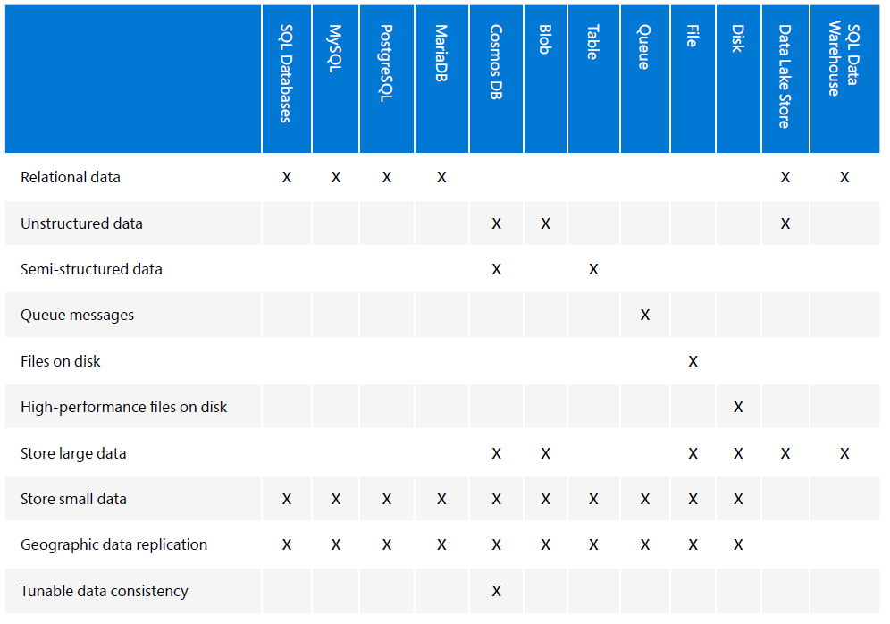
02
DATA
Notes:
SQL Server on VM
PostgresSQL

Slide 13
Next
Messaging

Slide 14

04
MESSAGING
Messages
Storage
Queue

Slide 15




04
MESSAGING
Events
Event
Hubs
Event
Grid
Service
Bus
Queue
Service
Bus
Topic

Slide 16
Next
Scaling

Slide 17
05
SCALING
Scaling
Instances
Auto scaling
VMSS
DTU
RU
Extra Nodes
...

Slide 18
Next
Performance & Availability

Slide 19



06
PERFORMANCE
&
AVAILABILITY
Performance & Availability
Traffic
Manager
Application
Gateways
Load
Balancers
Availability
Zones

Slide 20
Next
Networking

Slide 21




07
NETWORKING
Networking
DNS
Virtual
Networks
Express
Route
VPN
Gateway

Slide 22
Next
All Kind

Slide 23



08
ALL KIND
Security
Notes:
AAD – For Developers, B2C, Domain Services,
Key Vault
Multi-Factor Authentication

Slide 24





08
ALL KIND
???
Notes:
Media Services
Search
Cognitive Services (Text Analytics, Face API, Computer Vision API, Custom Vision API, Speech, …)
Bot Services
API Management

Slide 25
09
CoE
Azure CoE

Slide 26
10
QUESTIONS
Questions
???

Slide 27
10
Links
Links
https://vstsdemogenerator.azurewebsites.net

